Slide 1
Production and Costs (Part 1)
Chapter 19: Production and Costs

Slide 2
The Firm’s Objective
Firm’s Objective for producing goods and services ➔ PROFIT MAXIMAZTION
Profit = Total Revenues – Total Cost
Total Revenue = Price per unit * No. of units sold
Total costs can be divided into two types: Explicit costs and implicit costs.
Numerically…

Slide 3
All About Costs
An explicit cost is a cost that is incurred when an actual payment is made.
An implicit cost represents the value of resources used in production for which no actual payment is made. This is incurred as a result of a firm using its own resources that it owns or that the owners of the firm contribute to it.

Slide 4
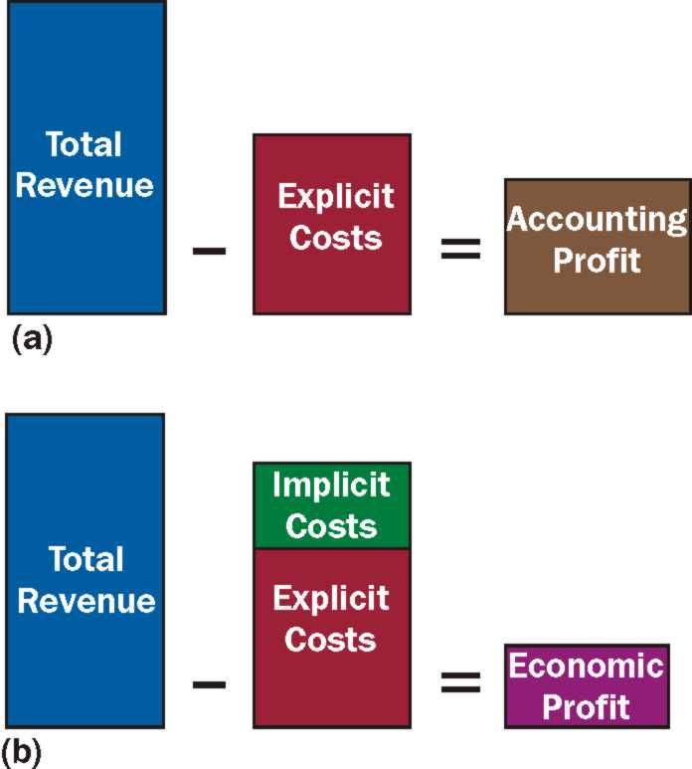
Accounting Profit Versus Economic Profit
Accounting Profit is the difference between total revenue and explicit costs.
Economic Profit is the difference between total revenue and total opportunity cost, including both its explicit and implicit components

Slide 5
Zero Economic Profit Is Not as bad As it Sounds.
It is possible for a firm to earn both a positive accounting profit and a zero economic profit.
Zero Economic Profit/Normal Profit: A firm that earns normal profit is earning revenue equal to its total costs (implicit and explicit). This is the level of profit necessary to keep resources employed in a firm.
A firm that makes zero economic profit is said to be earning normal profit.
Zero economic profit means the owner has generated total revenues sufficient to cover total opportunity costs.

Slide 6
Production
Production is a transformation of resources or inputs into goods and services.
A fixed input is an input whose quantity cannot be changed as output changes in the short run. The costs associated with fixed inputs are fixed costs. A fixed cost doesn’t change as output changes.
A variable input is an input whose quantity can be changed as output changes in the short run. The costs associated with variable inputs are variable costs. A variable cost changes as output changes
The short run is a period in which some inputs are fixed.
The long run is a period in which all inputs can be varied.

Slide 7
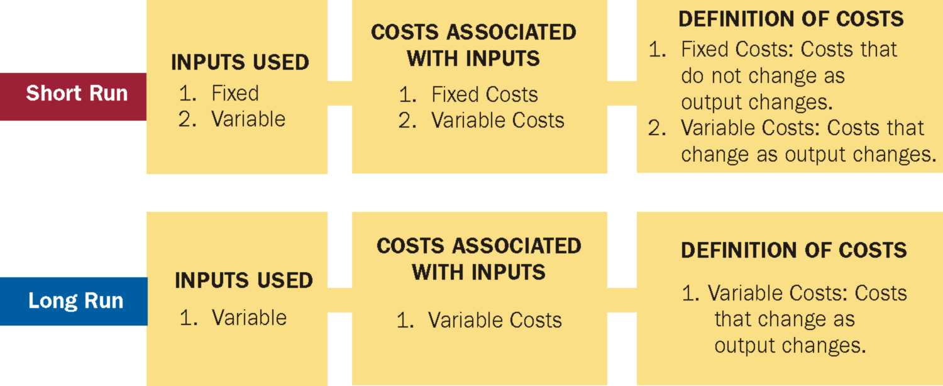

Slide 8
Production in the Short Run
Assume there are two inputs (resources): labour and capital.
Assume capital is fixed (the amount of capital that can be used is fixed).
Are we in the long run or in the short run?
Total Physical Product: The total quantity of output that is produced.
Marginal Physical Product: The change in output that results from changing the variable input by one unit, holding all other inputs fixed.

Slide 9
Example:
Fixed Input, Capital (units) | Variable Input, Labor (workers) | Quantity of Output, Q (units) | Marginal Physical Product of Variable Input
1 | 0 | 0 | 0
1 | 1 | 18 | 18
1 | 2 | 37 | 19
1 | 3 | 57 | 20
1 | 4 | 76 | 19
1 | 5 | 94 | 18
1 | 6 | 111 | 17
1 | 7 | 127 | 16
1 | 8 | 137 | 10
1 | 9 | 133 | -4
1 | 10 | 125 | -8

Slide 10
Production in the Short Run (CONT)
Law of Diminishing Marginal Returns: As even larger amounts of a variable input are combined with fixed inputs, eventually the marginal physical product of the variable input will decline.
The law of diminishing marginal returns says that as more units of the variable input are added, each one has fewer units of the fixed input to work with; consequently, output rises at a decreasing rate.
If the law of diminishing marginal returns did not hold, then it would be possible to continue to add additional units of a variable input to a fixed input, and the marginal physical product of the variable input would never decline. We could increase output indefinitely as long as we continued to add units of a variable input to a fixed input.

Slide 11
Production in the Short Run (CONT)
The point at which the MPP of labour first declines is the point at which diminishing marginal returns are said to have set in.
Would you hire the 4th worker even when you know MPP will fall to 19?
What will you can sell the additional 19 units for $100 but the cost of the firm to hire the 4th worker is $70?

